Slide 1
Chapter 5
File Handling
11:11PM

Slide 2
Index
Introduction
Data Files
Opening and Closing Files
Working with Text Files
Standard Input, Output and Error Streams
Working with Binary Files
Working with CSV Files

Slide 3
Introduction
In programming, data stored in memory (RAM) is temporary and gets lost when a program ends.
To store data permanently, we use files on secondary storage devices.
File handling in Python refers to the process of creating, reading, writing, appending, and managing data stored in files on secondary storage devices like hard disks.
It helps in managing large amounts of data efficiently and securely.
This chapter explains file concepts and basic file operations in Python.

Slide 4
Data Files
A data file is used to store data permanently on a storage device so that it can be accessed later. In Python, data files are mainly classified into :
Text Files
Binary Files.
Text File : Text files store data in the form of human-readable characters. The contents of a text file can be easily read and edited using a simple text editor such as Notepad. These files usually have extensions like .txt, .csv, or .log.

Slide 5
Text files are further divided into the following types:
a) Regular Text Files : Regular text files store data as plain text, where information is written in a simple readable format. Each line generally contains one piece of information or a complete record. These files are easy to create and understand but are not suitable for storing complex data structures. These files have .txt file extention.
Delimited Text Files : Delimited text files store data in which different fields are separated by a special character called a delimiter. Common delimiters include comma (,), tab (\t), and semicolon (;). Each line usually represents one record, making these files suitable for tabular data. These file have file extention like .csv

Slide 6
Binary Files : Binary files store data in binary (0s and 1s) format. These files are not human-readable and require a specific program to interpret the data. Binary files can store complex data such as images, audio, video, or Python objects using modules like pickle.
Binary files are more efficient in terms of storage and processing speed but cannot be edited using a text editor.
Examples of binary files: .dat, .bin, .jpg, .mp3

Slide 7
Why is a Binary File Faster than a Text File? (2018, 2022)
A binary file stores data in 0s and 1s and is not human-readable. It is faster than a text file because data is stored in raw form without conversion, occupies less space, and allows faster read and write operations.
Reason | Explanation
No conversion needed | Binary files store data in raw form. Text files need conversion (number → string while writing, string → number while reading).
Less storage space | Binary representation uses fewer bytes compared to text representation.
Direct memory access | Data can be read directly into memory structures.
Faster read/write operations | CPU processes binary data more efficiently.
Exact data storage | No loss of precision (important for floats, images, etc.).

Slide 8
Difference between Text File and Binary File (2016, 2018, 2020, 2023)
Basis | Text File | Binary File
Data storage | Stores data as characters (letters, digits, symbols) | Stores data in binary form (0s and 1s)
Readability | Human-readable | Not human-readable
Data format | Data is stored as strings | Data is stored in raw memory format
Conversion needed | Yes (number ↔ string) | No conversion required
Speed | Slower due to conversion | Faster as no conversion is needed
File size | Larger in size | Smaller in size
Accuracy | May lose precision (e.g., floating values) | Stores exact data
Editing | Can be edited using text editor | Cannot be edited using text editor
Portability | More portable across systems | Less portable
Examples | .txt, .csv, .py | .dat, .bin, .exe, .jpg

Slide 9
Opening and Closing Files
Opening a File in Python :
To work with a file, it must be opened using the built-in open() function.
file_object = open("filename", "mode")
Example :
f = open("data.txt", "r")
Default mode is r (read mode)

Slide 10
File Opening Modes
Mode | Meaning
r | Read (file must exist)
w | Write (creates new file / overwrites existing file)
a | Append (adds data at end of file)
r+ | Read and write
w+ | Write and read (overwrites file)
a+ | Append and read
rb | Read binary file
wb | Write binary file
ab | Append binary file

Slide 11
Closing a File :
After file operations are complete, the file should be closed to free system resources.
file_object.close()
Example:
f = open("data.txt", "r")
print(f.read())
f.close()
Using with automatically closes the file, even if an error occurs. No need to write close() explicitly.
with open("data.txt", "r") as f:
print(f.read())

Slide 12
Working with Text Files
Reading from Text Files :
Python provides three main methods to read data from a text file:
read()
readline()
readlines()
read() Method :
The read() method reads the entire contents of the file and returns it as one string.

Slide 13
Syntax :
file_object.read()
Example :
f = open("sample.txt", "r")
data = f.read()
print(data)
f.close()
Reads whole file at once
Output is a string
File pointer moves to the end of file
Suitable for small files

Slide 14
readline() Method :
The readline() method reads one line at a time from the file.
Syntax :
file_object.readline()
Example :
f = open("sample.txt", "r")
line1 = f.readline()
line2 = f.readline()
print(line1)
print(line2)
f.close()
Reads single line
Includes newline character (\n)
Useful for line-by-line processing

Slide 15
readlines() Method :
The readlines() method reads all lines of the file and returns them as a list of strings.
Syntax :
file_object.readlines()
Example :
f = open("sample.txt", "r")
lines = f.readlines()
print(lines)
f.close()
Each line becomes one list element
Newline character is included
Useful when working with lists

Slide 16
write() Method :
The write() method is used to write a string into a text file.
Syntax :
file_object.write(string)
Example :
f = open("sample.txt", "w")
f.write("Python File Handling\n")
f.write("Writing to text files")
f.close()
Writes only strings
Does not add newline automatically
Returns the number of characters written
Existing data is overwritten in w mode

Slide 17
writelines() Method :
The writelines() method writes multiple strings to a file using a list or sequence of strings.
Syntax :
file_object.writelines(list_of_strings)
Example :
f = open("sample.txt", "w")
lines = ["Python\n", "File Handling"]
f.writelines(lines)
f.close()
Writes a list of strings
Does not insert newline automatically
Newline (\n) must be added manually
Faster for writing multiple lines

Slide 18
Difference Between write() and writelines()
write() | writelines()
Writes a single string | Writes multiple strings
Used one line at a time | Uses list/sequence
Adds no newline | Adds no newline
Common in small writes | Better for bulk data

Slide 19
Appending to a Text File :
Appending means adding data at the end of an existing file without deleting old data.
This is done using append mode (a).
Append Mode (a) :
file_object = open("filename", "a")
File pointer is placed at the end of the file.
If file does not exist, it is created automatically.

Slide 20
Appending Using write() :
Using with Statement :
f = open("sample.txt", "a")
f.write("\nThis line is appended.")
f.close()
with open("sample.txt", "a") as f:
f.write("\nFile closed automatically")
Appending Using writelines() :
f = open("sample.txt", "a")
data = ["\nNew Line 1", "\nNew Line 2"]
f.writelines(data)
f.close()

Slide 21
Append and Read Mode (a+) :
f = open("sample.txt", "a+")
f.write("\nAppending and reading")
f.seek(0) # move pointer to start
print(f.read())
f.close()
What happens if you don’t use seek() in a+ mode?
When a file is opened in a+ mode (append + read), the file pointer is placed at the end of the file. If seek() is not used in a+ mode, any read operation will return no output (empty string) because the file pointer is already at the end of the file.

Slide 22
Difference between write() and writelines() :
write() | writelines()
Writes a single string to a file | Writes a list of strings to a file
Used for writing one line at a time | Used for writing multiple lines together
Returns number of characters written | Does not return any value

Slide 23
Difference between Write Mode (w) and Append Mode (a) :
w Mode | a Mode
Overwrites existing file content | Adds data at the end of file
Deletes old data | Preserves old data
File pointer starts at beginning | File pointer starts at end

Slide 24
Difference between Append (a) and Append-Read (a+) :
a Mode | a+ Mode
Used only for appending | Used for appending and reading
File pointer at end | File pointer at end
Cannot read file | Can read file after seek()

Slide 25
The flush() Function :
The flush() function is used to forcefully write (flush) any buffered data to the file immediately.
Normally, Python stores written data in a buffer and writes it to the file later.
flush() ensures that whatever is in the buffer is saved to the file right now.
Definition :
The flush() function clears the file buffer by writing all buffered data to the file without closing it.

Slide 26
What is a Buffer (in File Handling)?
A buffer is a temporary memory area (RAM) where data is stored before being written to a file.
When you use write() or writelines(), Python does not write data directly to the file.
It first stores it in the buffer.
A buffer is a temporary memory area that holds data before it is permanently written to a file.

Slide 27
Syntax :
file_object.flush()
Why is flush() Needed?
To make sure data is saved immediately
Useful when:
Writing data continuously
Program may terminate unexpectedly
File is read by another program while still open
flush() does not close the file.

Slide 28
Removing Whitespaces After Reading from a File
When we read data from a text file, it often contains:
Leading spaces
Trailing spaces
Newline character \n
Python provides string methods to remove these whitespaces after reading.
strip() – Remove spaces from both sides :
Removes leading and trailing whitespaces, including \n.
Syntax :
string.strip()

Slide 29
lstrip() – Remove leading whitespaces only :
Syntax :
string.lstrip()
rstrip() – Remove trailing whitespaces only :
Syntax :
string.rstrip()
Why is rstrip() used after readline()? (2018, 2020, 2023)
readline() reads a line along with the newline character \n.
rstrip() is used to remove this trailing newline character.

Slide 30
Differentiate between strip(), lstrip() and rstrip(). (2018, 2021, 2024)
Method | What it removes | Position of whitespaces removed
strip() | Leading and trailing whitespaces | Both left and right sides
lstrip() | Leading whitespaces only | Left side
rstrip() | Trailing whitespaces only | Right side

Slide 31
Significance of File Pointer in File Handling
A file pointer is a marker that shows the current position in a file from where data will be read or written next. Whenever a file is opened, the file pointer is automatically placed at the beginning of the file.
It keeps track of the current location in the file.
It helps in reading or writing data sequentially.
It allows random access to different positions in a file using functions like seek()
It prevents data from being read or written at the wrong location.
It is automatically updated after every read or write operation.

Slide 32
File Modes and Opening Position of File Pointer
File Mode | Purpose | Opening Position of File Pointer
"r" | Opens a file for reading only | Beginning of the file
"w" | Opens a file for writing; creates a new file or overwrites existing content | Beginning of the file
"a" | Opens a file for appending data | End of the file
"r+" | Opens a file for both reading and writing | Beginning of the file
"w+" | Opens a file for reading and writing; overwrites existing content | Beginning of the file
"a+" | Opens a file for reading and appending | End of the file
"rb" | Opens a binary file for reading | Beginning of the file
"wb" | Opens a binary file for writing | Beginning of the file
"ab" | Opens a binary file for appending | End of the file

Slide 33
Standard Input, Output and Error Streams
In file handling, Python uses three standard streams to perform input, output, and error-related operations. These streams act as communication channels between the user, program, and files.
Stream | Meaning | Purpose | Default Device
stdin | Standard Input Stream | Takes input into the program | Keyboard
stdout | Standard Output Stream | Displays normal output | Monitor/Screen
stderr | Standard Error Stream | Displays error messages | Monitor/Screen

Slide 34
Standard Input Stream (stdin)
Used for taking input from the user.
Data entered through the keyboard can later be stored in a file.
name = input("Enter your name: ")
f = open("data.txt", "w")
f.write(name)
f.close()
Input is taken through stdin.
The entered data is written into a file.

Slide 35
Standard Output Stream (stdout)
Used to display output on the screen.
Data read from a file is usually displayed using stdout.
f = open("data.txt", "r")
data = f.read()
print(data)
f.close()
Data is read from the file.
print() sends the output to stdout (screen).

Slide 36
Standard Error Stream (stderr)
Used to display file-related error messages.
Helps identify problems during file operations.
f = open("abc.txt", "r")
Possible Output :
FileNotFoundError: [Errno 2] No such file or directory: 'abc.txt'
This error message is displayed through stderr.

Slide 37
Absolute and Relative Paths
A path specifies the location of a file or folder in a computer system. In Python file handling, paths are used to open and access files.
Paths are mainly of two types:
Absolute Path
Relative Path
Absolute Path
An absolute path gives the complete location of a file starting from the root directory or drive.
It contains the full path of the file.
It does not depend on the current working directory.

Slide 38
It always points to the same location.
One major disadvantage is that absolute paths are long and may not work if the file location changes.
Relative Path
A relative path specifies the file location with respect to the current working directory.
It does not start from the root directory.
It is shorter and easier to write.
It depends on the current folder.
Relative paths are preferred in projects because:
Relative paths are shorter, easier to write, and make projects portable
Files can be moved easily from one system to another.

Slide 39
Difference Between Absolute and Relative Path
Absolute Path | Relative Path
Gives complete file location | Gives location relative to current directory
Starts from root directory or drive | Starts from current folder
Independent of current working directory | Depends on current working directory
Longer path | Shorter path

Slide 40
Working with Binary Files
Binary files are used for storing complex objects because they can store data in the same internal format used by the computer (0s and 1s).
Unlike text files, binary files can directly store Python objects such as dictionaries, tuples, lists, and nested structures without converting them into strings, so that they are stored in a way that their structure/hierarchy is maintained.

Slide 41
Pickle Module in Python
Python provides a built-in module called pickle to store and retrieve Python objects from binary files.
The pickle module converts Python objects into a binary format before storing them in a file and converts them back into Python objects when reading from the file.
Serialization
Serialization is the process of converting Python objects into binary format so that they can be stored in a binary file.

Slide 42
It is done using:
pickle.dump()
Syntax : pickle.dump(object, file)
Unpickling (Deserialization)
Unpickling is the process of converting binary data back into Python objects.
It is done using:
pickle.load()
Syntax : pickle.load(file)

Slide 43
Creating/Opening/Closing Binary Files
In Python, binary files are handled using binary modes such as "rb", "wb", and "ab".
Creating a Binary File
A binary file is created using the open() function with write binary mode ("wb").
Syntax : file_object = open("filename.dat", "wb")
Example :
f = open("student.dat", "wb")
print("Binary file created")
f.close()
If the file already exists, its contents are overwritten.

Slide 44
Opening a Binary File
Binary files can be opened in different modes depending on the operation.
Mode | Purpose
"rb" | Read binary file
"wb" | Write binary file
"ab" | Append binary file
Opening for Reading
Syntax : file_object = open("filename.dat", "rb")

Slide 45
Opening for Appending
Syntax : file_object = open("filename.dat", "ab")
Closing a Binary File
After completing file operations, the file should be closed using the close() method.
Syntax : file_object.close()
Closing is important because :
Saves all changes permanently
Frees system resources
Prevents data corruption
Avoids memory wastage

Slide 46
Writing onto a Binary File – Pickling
Writing data onto a binary file using the pickle module is called Pickling or Serialization.
In this process, Python objects are converted into binary format and stored in a binary file.
Syntax : pickle.dump(object, file)
Appending Records in Binary Files
Appending means adding new data at the end of an existing binary file without deleting the old contents.
In Python, binary files are opened in append binary mode ("ab") for appending records.
Python uses the pickle module to append Python objects into binary files.

Slide 47
Reading from a Binary File – Unpickling
Reading data from a binary file using the pickle module is called Unpickling or Deserialization.
In this process, binary data stored in the file is converted back into the original Python object.
Syntax : pickle.load(file)

Slide 48
pickle.load() Raises EOFError
When reading multiple records from a binary file, pickle.load() keeps reading objects one by one.
At the end of the file, no more data is available, so pickle.load() raises an EOFError (End Of File Error).
To handle this error safely, we use:
try-except block
with statement along with try-except

Slide 49
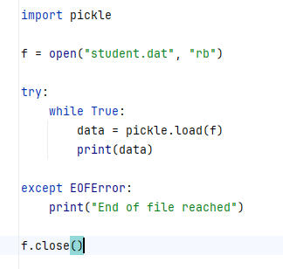
Using try-except with pickle.load()
pickle.load(f) reads one object at a time
When all records are read, EOFError occurs
except EOFError handles the error and stops the program safely

Slide 50
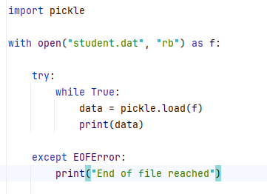
Using with Statement
The with statement automatically closes the file after use.
The with statement automatically handles file closing, but it does not remove the need for try-except in all cases.
with does not handle errors like: EOFError and FileNotFoundError. So while reading binary files using: pickle.load() we still need try-except EOFError because: pickle.load() raises EOFError at end of file
with only manages opening and closing

Slide 51
Difference between with statement and try-except
with statement | try-except
Automatically closes file | Handles runtime errors
Used for resource management | Used for exception handling
Does not handle EOFError | Can handle EOFError

Slide 52
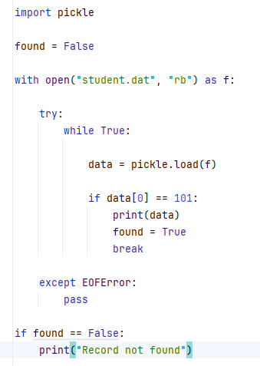
Searching in a Binary File
In binary files, records are read using pickle.load() and compared with the search value.
pickle.load() reads one record at a time
data[0] == 101 searches Roll Number 101
EOFError handles end of file

Slide 53
Updating Records in a Binary File
Updating in a binary file means modifying an existing record stored in the file.
Since binary files do not allow direct modification of records easily, the common method is:
Read records from original file
Modify the required record
Write records into a temporary file
Replace original file with updated file
Python uses the pickle module for handling binary files.

Slide 54
Accessing and Manipulating Location of a File Pointer (Random Access)
A file pointer is a marker that indicates the current position in a file from where the next read or write operation will take place.
Normally, files are processed sequentially. But sometimes we need to directly move to a specific location in a file. This is called Random Access.
Python provides two functions for random access:
tell()
seek()

Slide 55
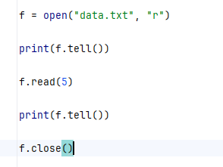
tell() Function
The tell() function returns the current position of the file pointer.
Syntax : file_object.tell()
Initially file pointer is at position 0
After reading 5 characters, pointer moves to position 5

Slide 56
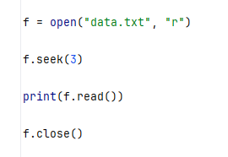
seek() Function
The seek() function is used to move the file pointer to a specific position in the file.
Syntax : file_object.seek(offset)
offset → position to move file pointer
seek(3) moves pointer to position 3
Reading starts from character at that position.

Slide 57
Random Access
Random access means directly accessing any position in a file without reading all previous data.
It is useful for:
Updating records
Searching large files
Fast data retrieval

Slide 58
Difference Between seek() and tell()
seek() | tell()
Moves file pointer | Returns current position
Used for random access | Used to know pointer location

Slide 59
Updating Records in a File
In binary files, records can also be updated using the position of the file pointer.
rpos means record position or the position where a particular record starts in the binary file.
Before reading a record, we store the current file pointer position using:
rpos = f.tell()
This position helps us move back to the same record later using seek() and update it.
This method is called Random Access Updating.

Slide 60
Working with CSV Files
A CSV (Comma Separated Values) file is a special type of text file used to store tabular data.
Each line in a CSV file represents a record, and the values within a record are separated by commas.
Although commas are the default delimiter in CSV files, other characters such as semicolon (;), colon (:), tab (\t), can also be used to separate values.
CSV files are useful for storing and transferring structured data.

Slide 61
Python CSV Module
Python provides a built-in csv module that makes it easy to read from and write to CSV files.
Importing the CSV Module:
import csv
The csv module provides two specific types of objects - the reader and writer objects - to read and write into CSV files.
csv.reader() Reads data from a CSV file
csv.writer() Writes data to a CSV file

Slide 62
Opening and Closing CSV Files
Before reading from or writing to a CSV file, the file must be opened.
After the operation is completed, it should be closed to free system resources and ensure that all data is properly saved.
Opening a CSV File
f = open("filename.csv", mode)

Slide 63
Common Modes
Mode | Purpose
"r" | Read an existing CSV file
"w" | Write to a CSV file (creates a new file or overwrites existing content)
"a" | Append data to an existing CSV file
"r+" | Read and write both

Slide 64
Closing a CSV File
Syntax :
f.close()
Why Close a File?
Releases system resources.
Ensures all buffered data is written to the file.
Prevents data loss or file corruption.
The with statement automatically closes the file after use. No need to write f.close() explicitly.

Slide 65
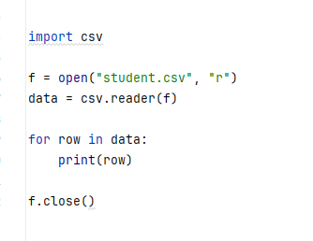
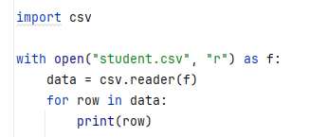

Slide 66
Role of newline Argument in Opening CSV Files
When writing CSV files, Python may insert extra blank lines between records on some operating systems (especially Windows).
To prevent this, the file should be opened with: newline=""
f = open("student.csv", "w", newline="")

Slide 67
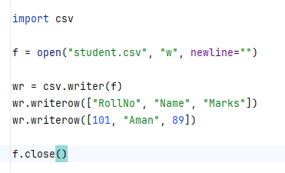
Why is newline="" Used?
Prevents extra blank lines between records.
Allows the csv module to handle line endings correctly.
Recommended whenever a CSV file is opened for writing.

Slide 68
Writing in CSV Files
Inorder to write into csv files, the user data is converted into writable delimited form and then it is stored in the form of csv files.
To write data into a CSV file, Python provides the csv.writer() function. The writer object can write data using:
writerow() → writes a single record (one row)
writerows() → writes multiple records (many rows)

Slide 69
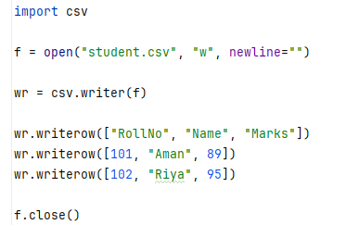
writerow()
Writes one row at a time to the CSV file.
Syntax :
writer.writerow(record)
where record is usually a list or tuple.

Slide 70
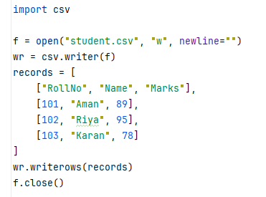
writerows()
Writes multiple rows at once.
Syntax :
writer.writerows(records)
where records is a list of lists or list of tuples.

Slide 71
Difference between writerow() and writerows()
writerow() | writerows()
Writes one record at a time | Writes multiple records at once
Takes a single list/tuple | Takes a list of lists/tuples
Called repeatedly for multiple records | Called once for all records
Useful when records are entered one by one | Useful when records are already available in a collection

Slide 72
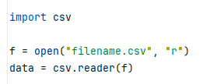
Reading in CSV Files
The csv.reader() function is used to read data from a CSV file.
It returns an object that reads the file row by row, where each row is represented as a list of strings.

Slide 73
Conclusion
Files provide a permanent way to store data for future use.
Python supports different types of files such as text files, binary files, and CSV files.
File operations include opening, reading, writing, appending, and closing files.
Various file modes (r, w, a, rb, wb, etc.) determine how a file is accessed.
Functions like seek() and tell() enable random access in files.
Binary files can be handled using the pickle module for storing and retrieving Python objects.
The csv module simplifies working with CSV files for tabular data storage.
File handling is an essential concept for developing real-world applications that require data storage and management.

